Slide 1
GROCERY STORE WEB APPLICATION
TEAM: ITG09
TEAM MEMBERS:
MONICA B (211521205087)
LATHIKA SARAN (211521205074)
MADHUMITHA G (211521205077)
MARIKINTI CHANDANA (211521205082)

Slide 2
Abstract
The grocery web application is a store front like an e-commerce website but of groceries as main selling stock products, this can be deployed into a full-stack MERN-based platform designed to provide users with a seamless and convenient online shopping experience. It allows customers to explore, add items to their cart, and securely purchase a wide variety of products, including tech gadgets, fashion, and everyday essentials.
The grocery web app is a full-stack MERN-capable design with the tech stack HTML,CSS and JS made platform-ready and designed to provide users with a seamless and convenient online shopping experience.

Slide 3
Introduction
With the rise of e-commerce, online grocery shopping has become a growing trend. Our grocery web app aims to meet the demand for a user-friendly and secure platform where customers can shop effortlessly from the comfort of their homes.
Built using the MERN stack (MongoDB, Express, React, Node.js), this app streamlines the shopping process, offering product categorization, secure checkout, and efficient order management for sellers.
The project focuses on delivering a reliable and enjoyable shopping experience while maintaining top-notch security for customer data.

Slide 4
Existing System
In the current market, various online grocery shopping platforms offer basic functionality for purchasing products. However, these systems often suffer from several limitations:
Limited User Experience
Inefficient Inventory Management
Security Concerns
Limited Seller Support
Poor Customer Support

Slide 5
Proposed System
The proposed grocery web app consists of a robust architecture:
Frontend: Built using React for dynamic, responsive user interaction, customers can browse categories, view products, and manage their shopping cart easily.
Backend: Powered by Node.js and Express, it handles database interactions, user authentication, order management, and checkout processes securely.
Database: MongoDB ensures efficient data storage, handling user accounts, product listings, inventory, and order details.
Admin & Seller Dashboards: Sellers can add and manage product listings and inventory, while admins have access to comprehensive tools to oversee app performance, respond to customer inquiries, and process payments.

Slide 6
Scope of the Project
User Registration & Login: Implement secure user authentication for customers and sellers, using secure protocols for data privacy.
Product Browsing & Filtering: Customers can browse products by category, apply filters, and view detailed product descriptions and reviews.
Shopping Cart & Checkout: Customers can add items to their cart, modify quantities, and proceed with secure payment options during checkout.
Seller Dashboard: Sellers can manage product listings, inventory levels, and view order histories.
Admin Panel: Administrators can view overall app performance, handle customer inquiries, and manage payments securely.

Slide 7
System Architecture:
Frontend (React): The UI/UX layer where users interact with the platform for browsing, shopping, and managing their profiles.
Backend (Node.js + Express): The middleware layer that manages communication between the frontend and the database, handling user authentication, cart management, and order processing.
Database (MongoDB): Stores user information, product listings, inventory data, and order histories, with quick retrieval and update capabilities.
Hosting & Deployment: The application is hosted on a cloud-based platform like AWS or Heroku, ensuring scalability and uptime.

Slide 8
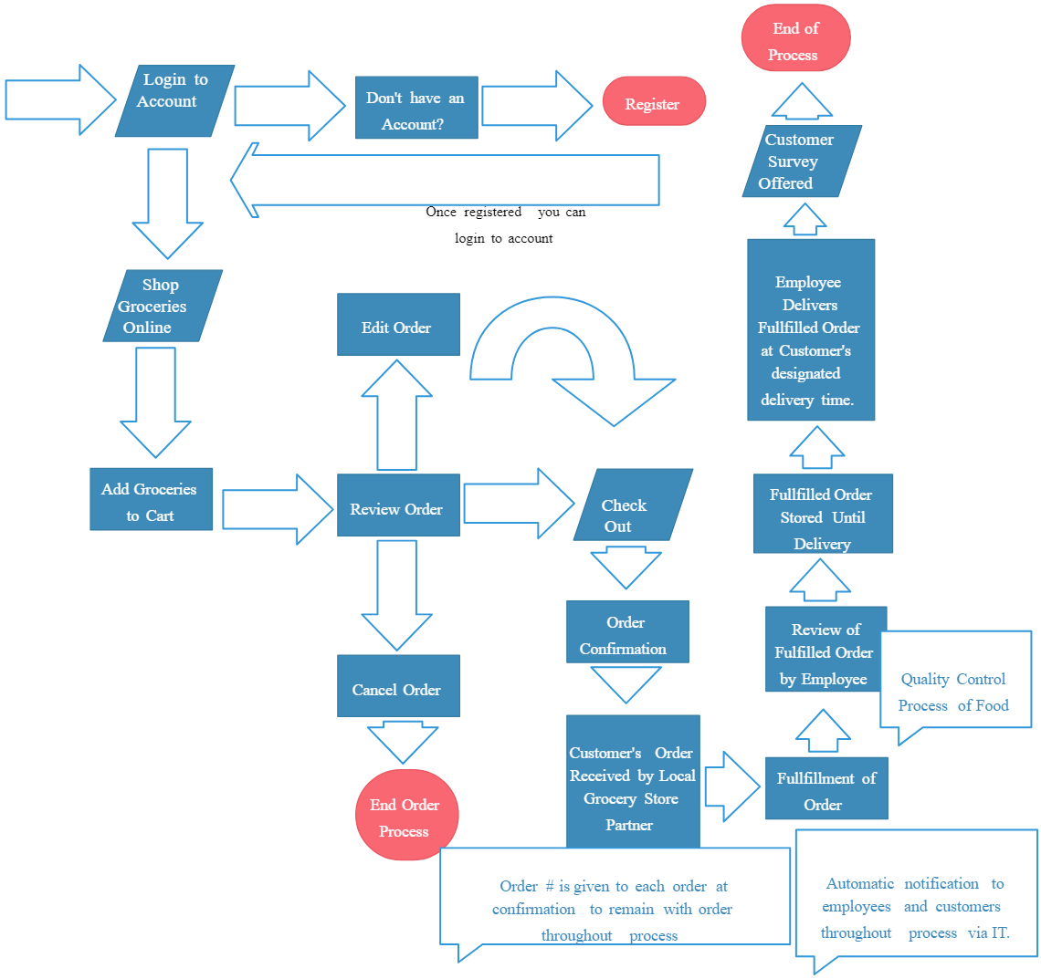
Flow Chart
of grocery web application process and system architecture

Slide 9
Features and Functionality:
Responsive Design: The app is fully responsive and works across all devices, including desktops, tablets, and smartphones.
Product Search: Users can search for specific products using keywords or category filters.
Real-time Inventory Management: Ensures that the products listed on the platform are up-to-date with current stock levels.
Secure Transactions: Encrypted payment methods and secure checkout options ensure that customers can shop with confidence.

Slide 10
Testing & Implementation
Unit Testing: Testing individual components such as product search, cart functionality, and checkout.
Integration Testing: Ensuring all system components work together, including frontend-backend interaction, and third-party payment gateway integration.
User Acceptance Testing (UAT): Running tests with real users to gather feedback and identify any usability issues before the final launch.
Deployment: After successful testing, the app is deployed to a cloud hosting service for public access, with continuous monitoring for performance.

Slide 11
Future Enhancements
Mobile App Development: Expanding the platform to include native mobile apps for Android and iOS.
AI-based Product Recommendations: Implementing machine learning algorithms to suggest products based on customer preferences and buying patterns.
Subscription Models: Introducing subscription services for recurring grocery deliveries on a weekly or monthly basis.
Loyalty Programs: Adding features like reward points, discounts, and cashback offers to encourage repeat customers.

Slide 12
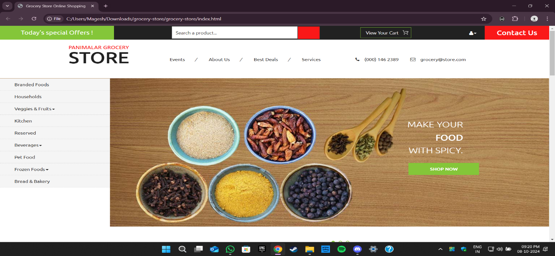
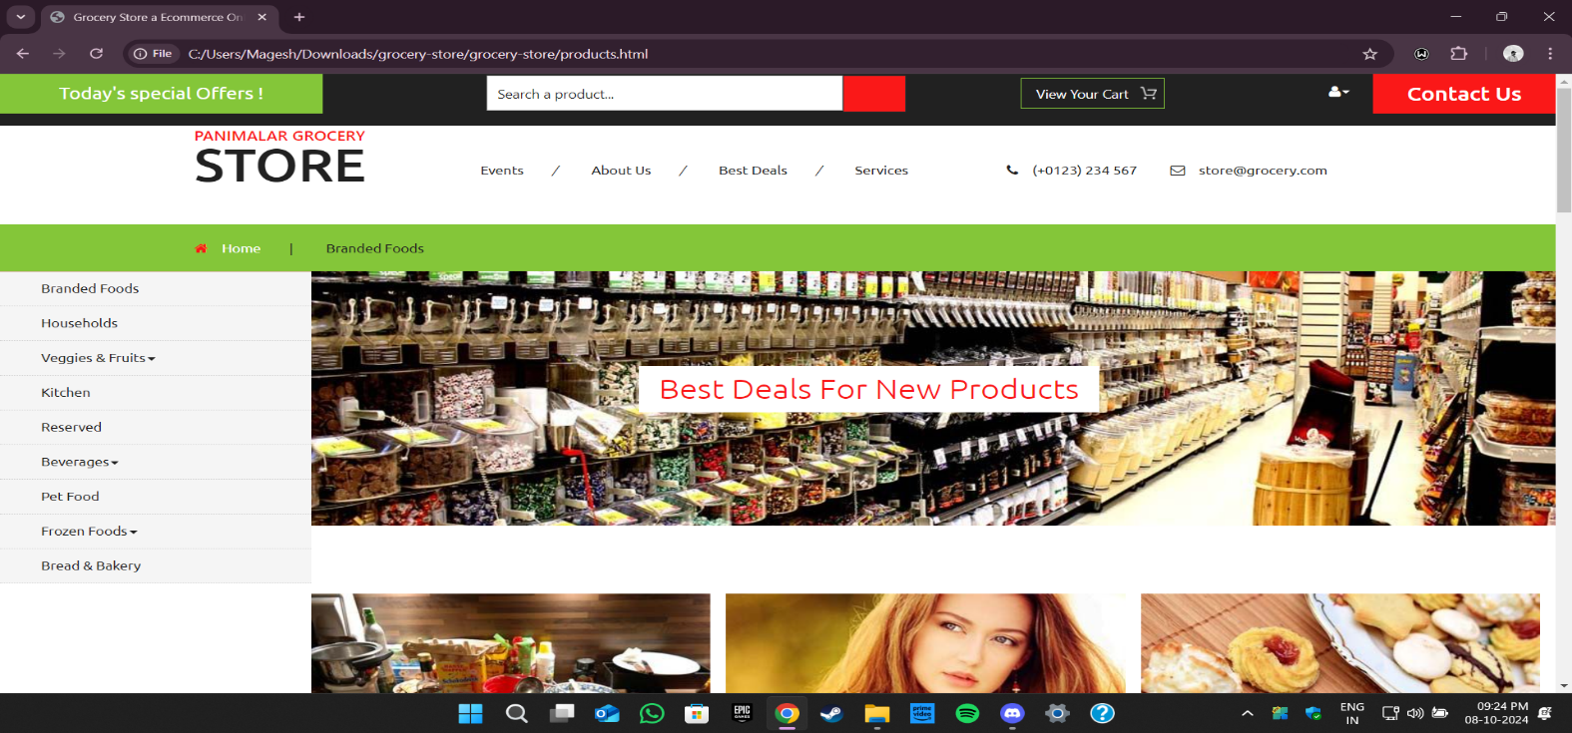
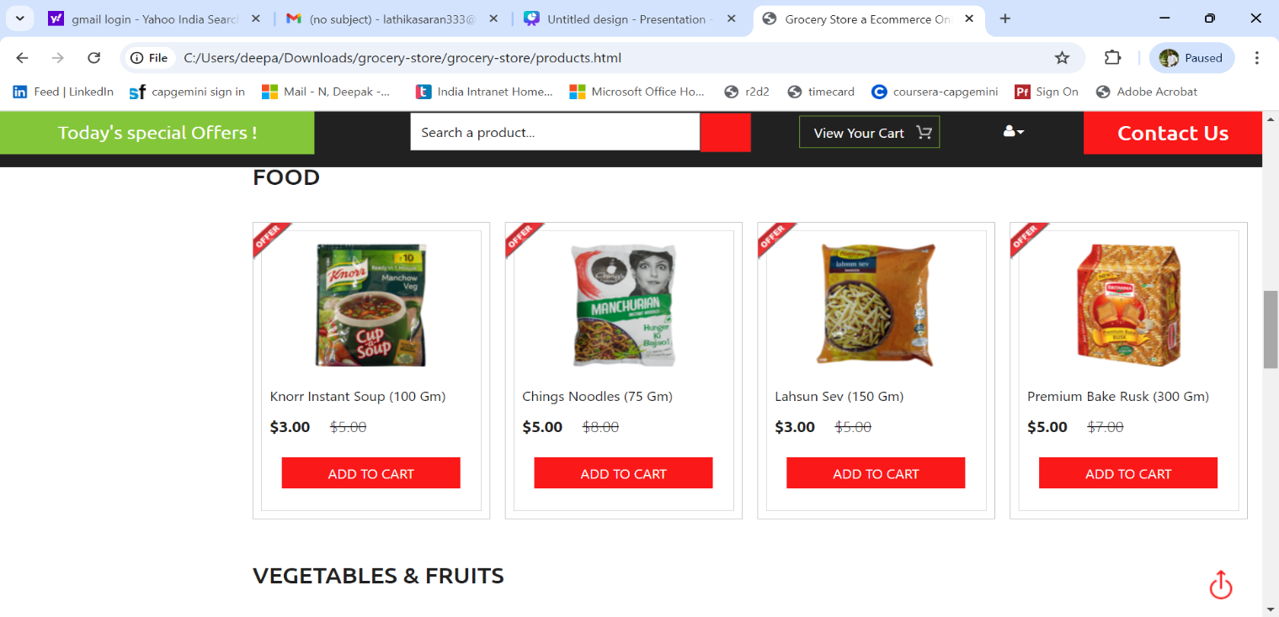
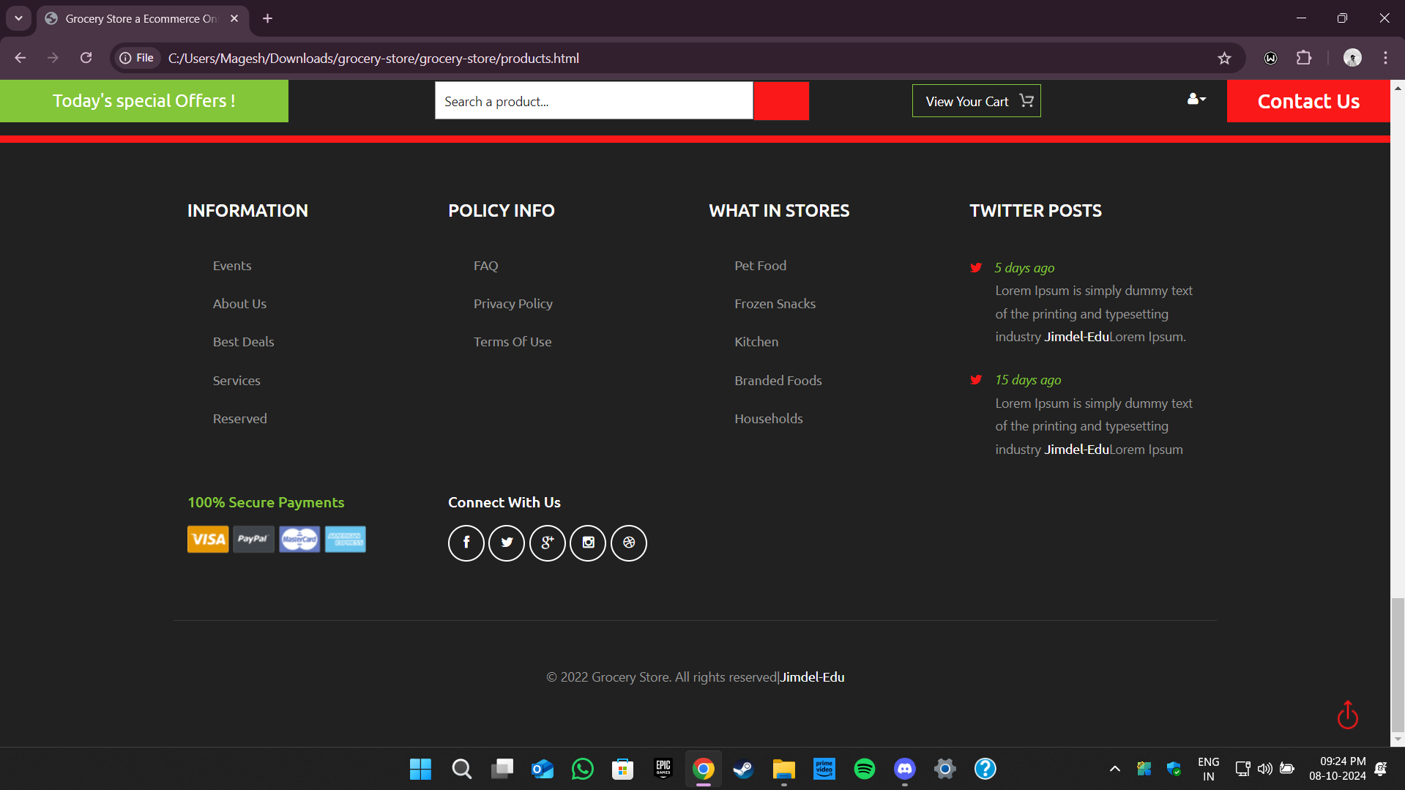
SNAPSHOTS OF THE WEB APPLICATION
BASIC MODULES:
Landing Page
Offers and Deals carousel on home page
Product listing under the searched category
Website footer section

Slide 13

Conclusion
The grocery web app provides a modern solution to the evolving needs of online shoppers and sellers. With a focus on seamless user experience, security, and efficient backend management, the platform stands as a comprehensive tool for digital grocery shopping. From product browsing to secure payments, this web app prioritizes both customer convenience and trust. As online shopping continues to grow, this app serves as a reliable and scalable system capable of handling the demands of a growing user base.

Slide 14
THANK YOU

